Slide 1
Recreating the Natural Wound Healing Environment
ACTIGRAFT
Biological Wound Care Device/ Treatment

Slide 2
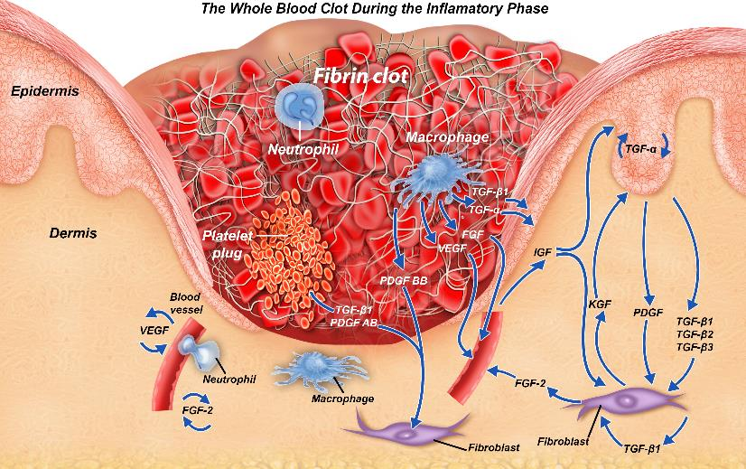
THE ACTIGRAFT WHOLE BLOOD CLOT: CONTAINS ALL HEALING COMPONENTS
Protective Scab
Granulation
Tissue
Fibrin Scaffold
Released
Bio-signals
Released Growth factors
Macrophages & Fibroblasts

Slide 3
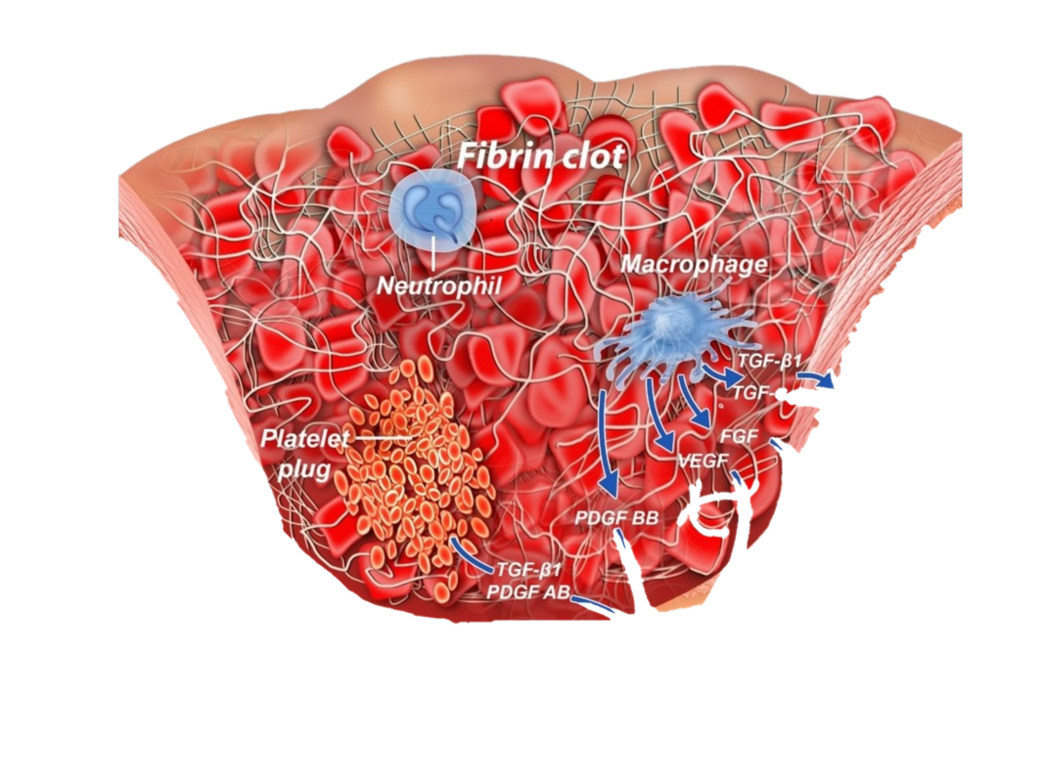
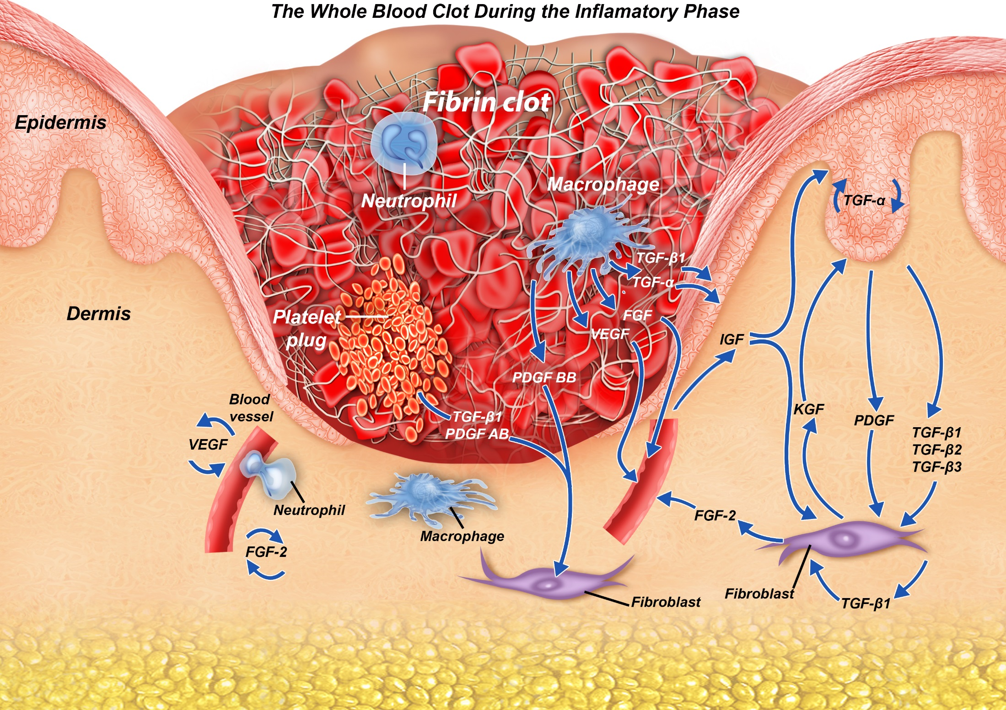
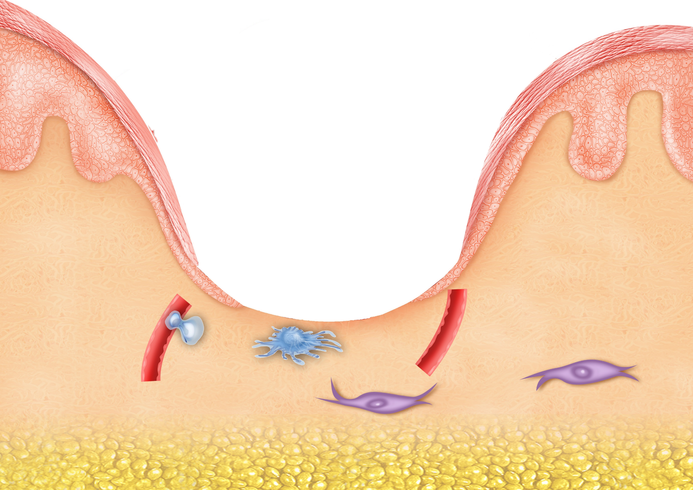

Slide 4
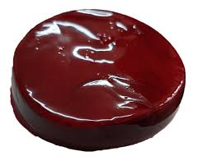
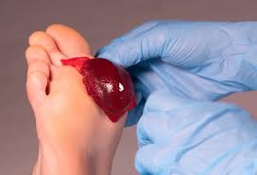
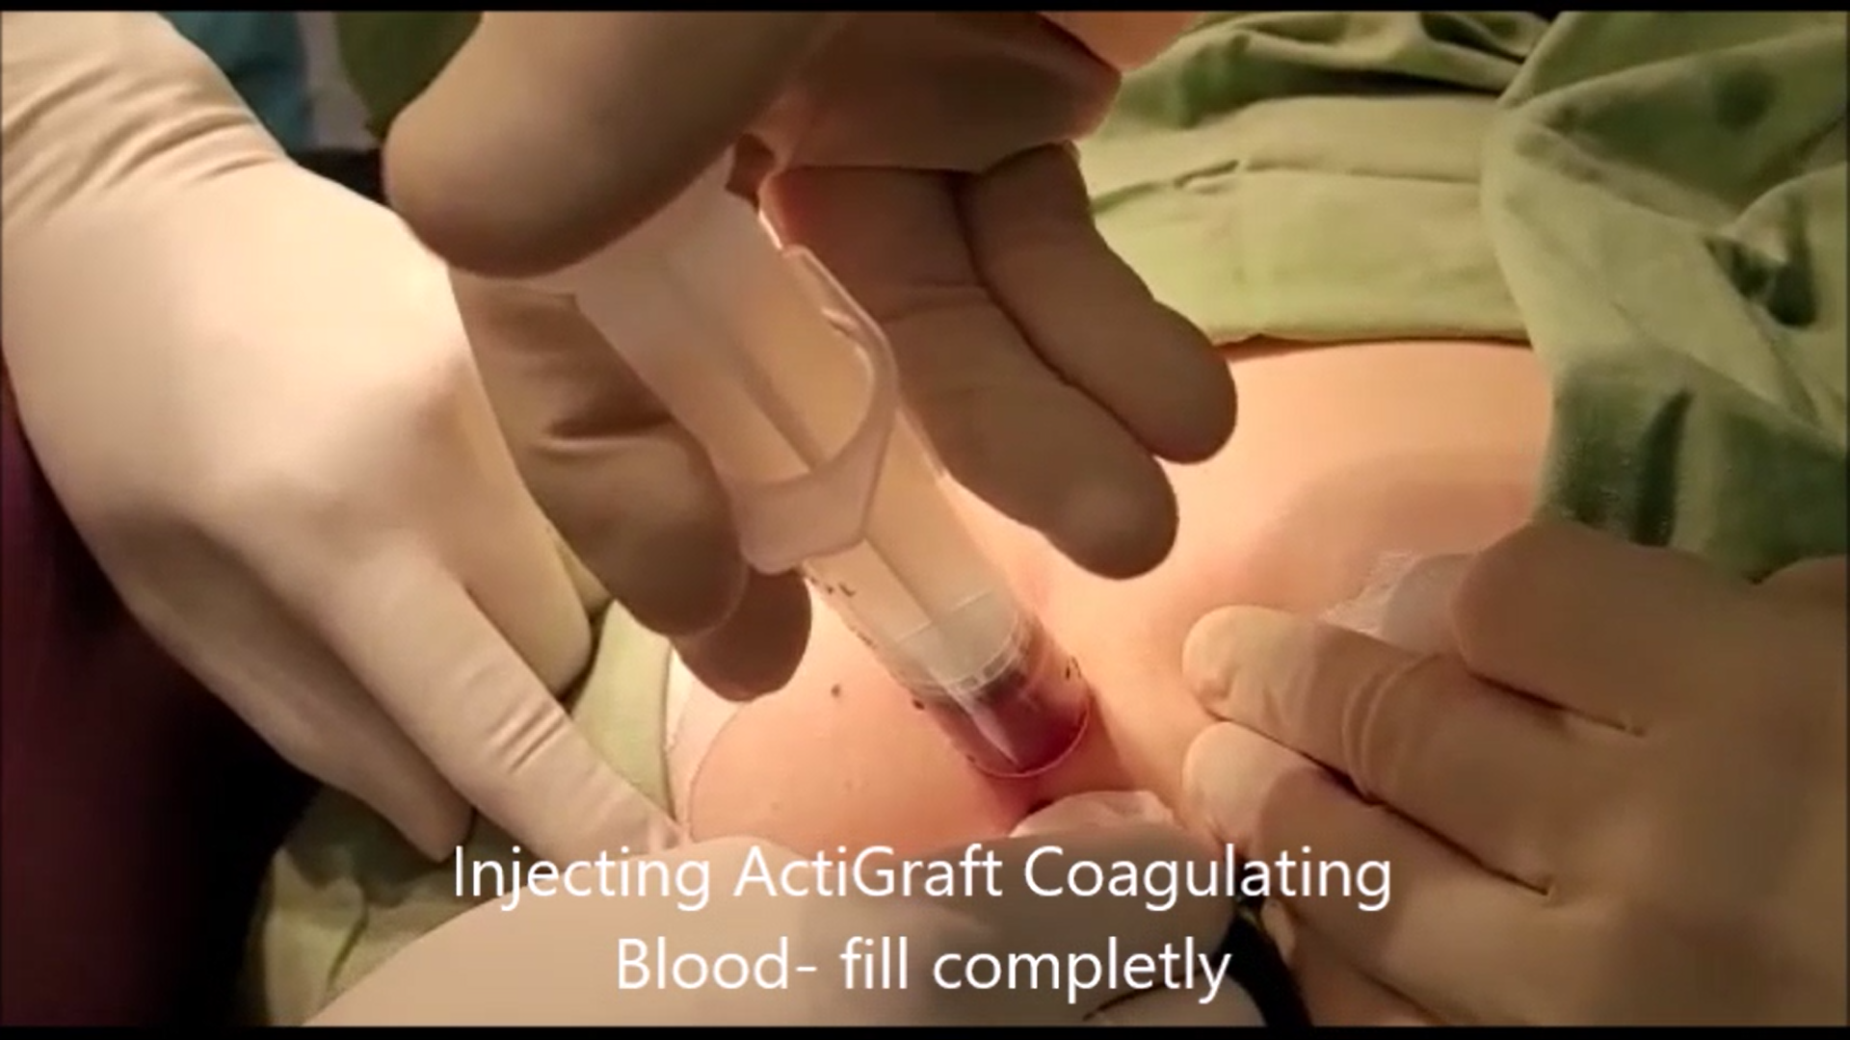
Treatment Options
ACTIGRAFT - Blood Clot
ACTIGRAFT - Liquid App.

Slide 5
WOUND Management CASCADE
Today’s wound care standard
Ozone
Neg. Pressure
Patient QOL
Wound Overexposure
Wound treatment Guessing
Game
Multiple products = guessing game
Hospital Re-admissions
Collagen
”Stuck”
Silver
Infection risk
PRP/PRF
Nursing Time

Slide 6
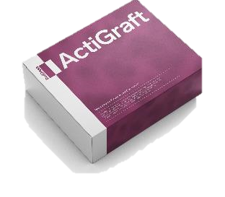
WOUND Management CASCADE
ActiGraft = all the elements of wound management
Forms a protective scab
Prevent Infection
Natural healing
Signaling pathways for normal healing progress
Scaffolding for cell migration
Promoted growth factors
ActiGraft takes guessing game out of healing management cascade

Slide 7
ACTIGRAFT ADVANTAGES:
Using the patient’s own blood.
Initiates and moderates natural healing process.
Promotes vascular growth.
Releases growth factors.
Acts as a scaffold.
Attracts macrophages.
Fight's infections.
Faster healing.
Remains active on the wound for prolonged periods (7 days).
Effective healing and minimally nursing time = significant cost reduction.
‹#›

Slide 8
ACTIGRAFT contra-indications and notes
Contra-Indications:
Malignant wounds
General infection
Notes & Remarks:
Make sure to perform a good thorough cleaning of the wound before the treatment.
Do not remove the ACTIGRAFT for 7 days.
Change external dressing after 3 days.
Severe wounds: minimum of 3-4 treatments/weeks for improvement.
Severe wounds require a minimum of 10 treatments for healing.
‹#›

Slide 9
ACTIGRAFT - Good For:
Chronic wounds:
Diabetic and Neuropathic Ulcers
Pressure & Vascular Ulcers.
Non-healing wounds.
Accelerate and improve healing of difficult to heal wounds:
Traumatic Wounds
Surgical & Post-Surgical Wounds
Skin Tears
Pilonidal Sinus
Annal fistula
Stoma removal wound
Internal Cyst
Gun shut wound
‹#›

Slide 10
ACTIGRAFT
Vs.
Other treatments
‹#›

Slide 11
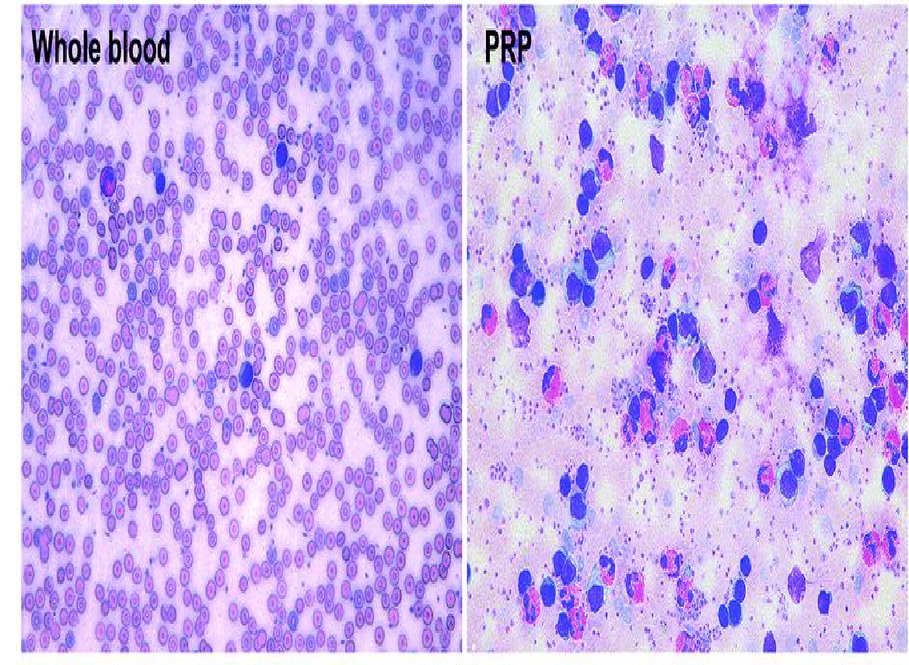
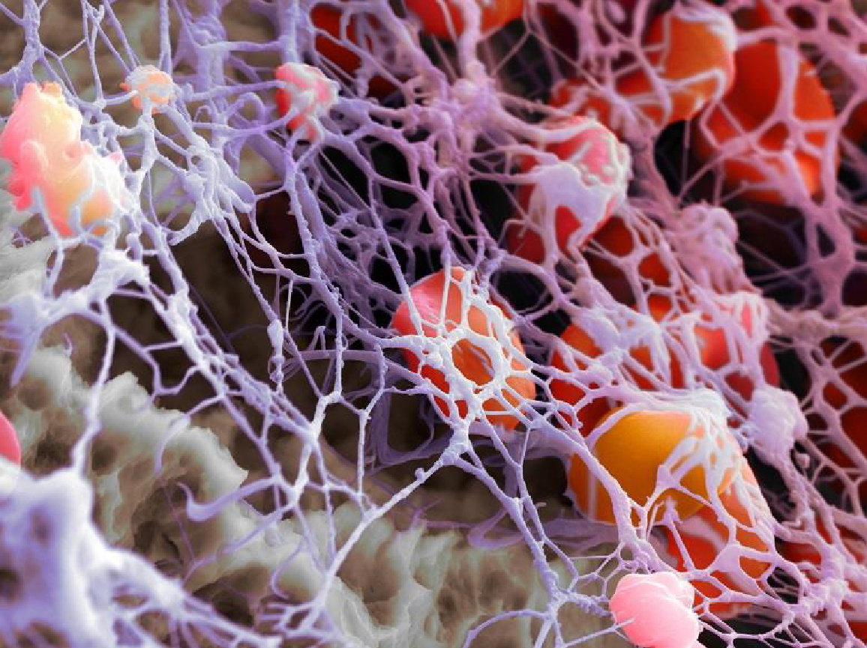
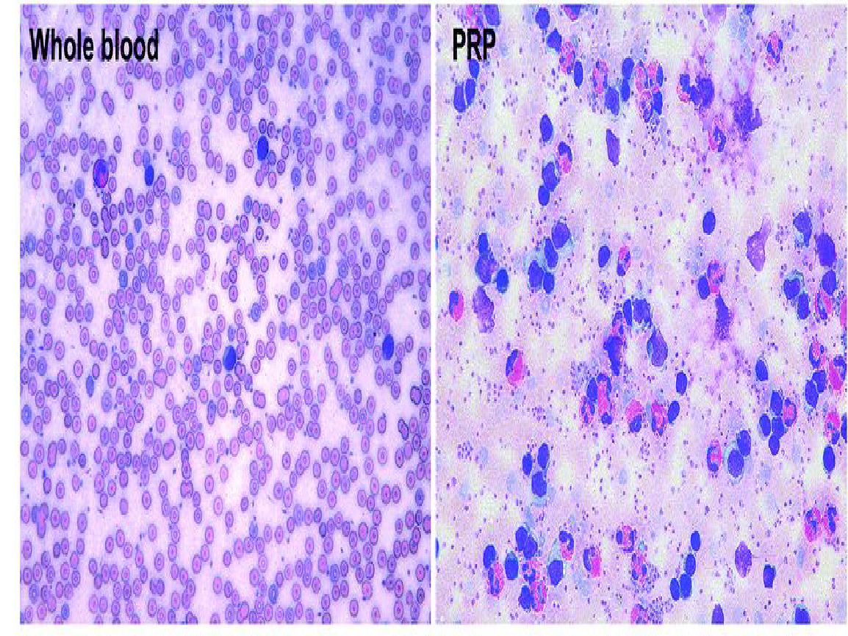
ACTIGRAFT vs. PRP
ACTIGRAFT
ACTIGRAFT vs. PRF
Natural Clot
ACTIGRAFT Clot
PRF (Platelet Reach Fibrin)

Slide 12
ACTIGRAFT | PRP (Platelet-rich plasma) | PRF, Growth factors & other blood products
A three-dimensional matrix containing a fibrin net, which forms a stable basis for growth factors and blood vessels, migration of cells, capturing of fluids, optimal distance between cells. | Liquid and unstable on the wound - there is no basis to support the growth factors to develop | Engineered in 3-layer product, lower layer is in contact with the wound, next 2 layers do not contact and cannot directly interact with the wound.
A blood clot formation creates a slow and controlled discharge according to the natural needs of the body | Liquid condition results in a rapid discharge and a significant decrease in the effectiveness of the treatment process | Destroy the natural balance of the natural wound environment created in a blood clot
A blood clot in the natural dose to the body | High concentration and not in whole blood composition - is not effective. (Example: in giving antibiotics do not take twice as many times to get a faster recovery) | by centrifuge, results in a very dense and rigid fibrin product, has no resemblance to how a natural fibrin scaffold should look
A natural evolutionary process of the body | Separation of blood components is not a natural healing process of the body | Processed blood product.

Slide 13
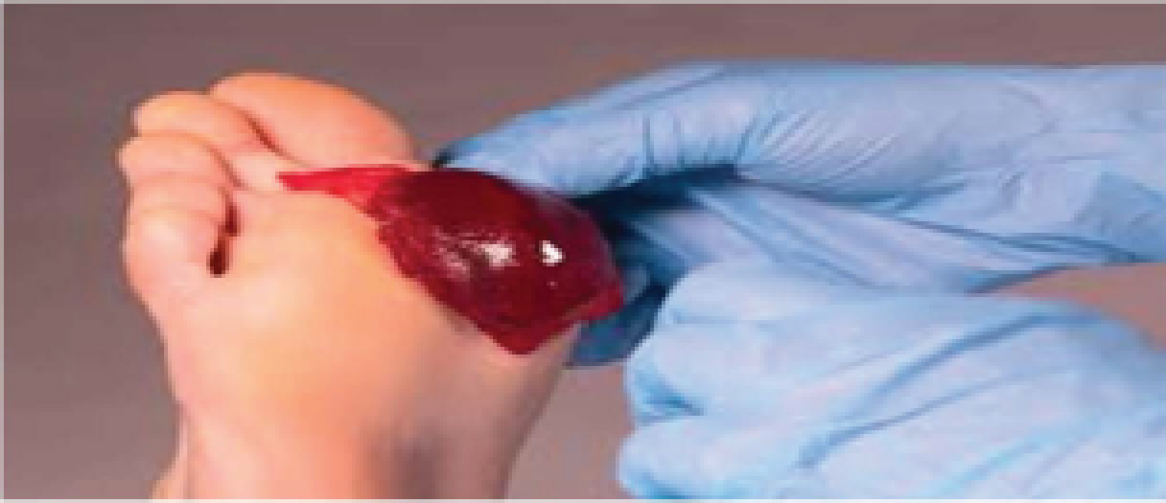
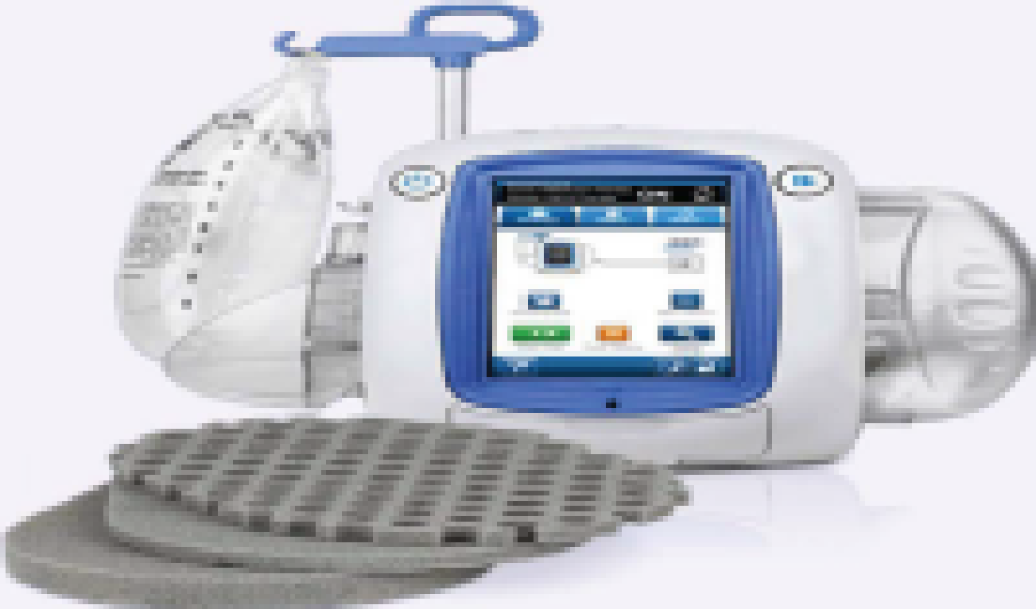
NEGATIVE WOUND PRESSURE THERAPY
Regenerative wound solution using patient's own blood to create an autologous whole blood clot tissue
vacuum assisted closure using a suction pump to remove excess exudate and promote healing
Requires 1 weekly application, every 7 days
Requires 2-3 dressing changes per week
No irritation of the dermal layer of the skin, pain reduction has been noted in 3 days
Patient may experience pain from vacuum, and at dressing changes
Minimized infection risk due to leaving wound undisturbed and reduced dressing changes
Frequent dressing changes increase contamination risk and infection; vacuum seal leakage can cause maceration, infection, and complications
Utilizing patient's own blood creates a natural healing environment
Not biologically active - Exposed to side effects
No Capital equipment or special storage
requirements
Purchase or rental of capital equipment is required as well as purchase of disposables
Ease of use enables deployment across care continuum and transition from acute to post-acute setting
trained nursing staff and frequent monitoring required to conduct in-servicing, competency updates to troubleshoot alarms, repair leaks, observe complications
Reduces risk of hospital readmissions
Complications can lead to patient readmissions spital
72.2% complete healing in average of 6 weeks (45 days) = cost reduction for complete healing
43.2% partial healing in 14 weeks (98 days).

Slide 14
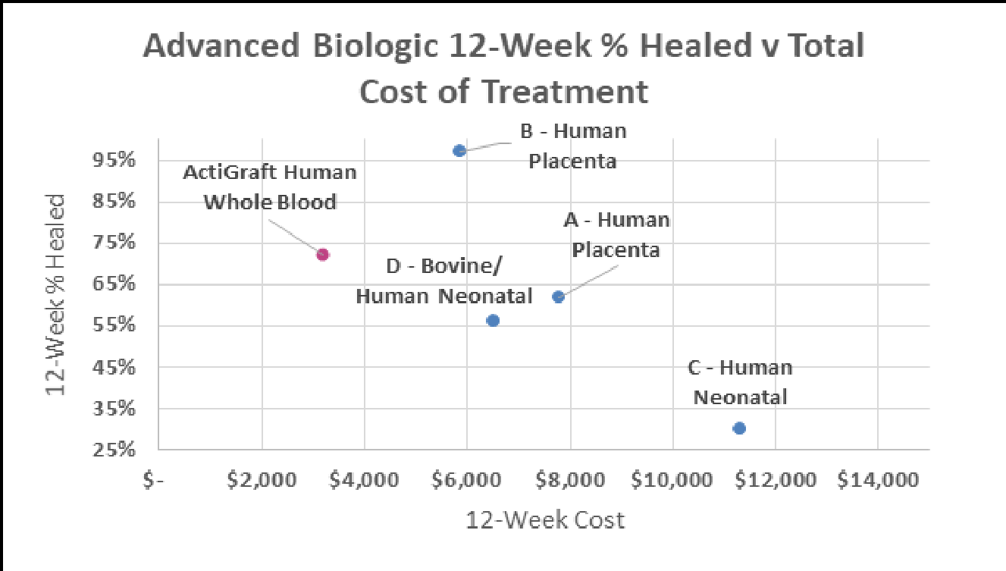
Biological Treatments - Comparison
(Embryonic cells)
‹#›

Slide 15
Recreating the Natural Wound Healing Environment

Slide 16
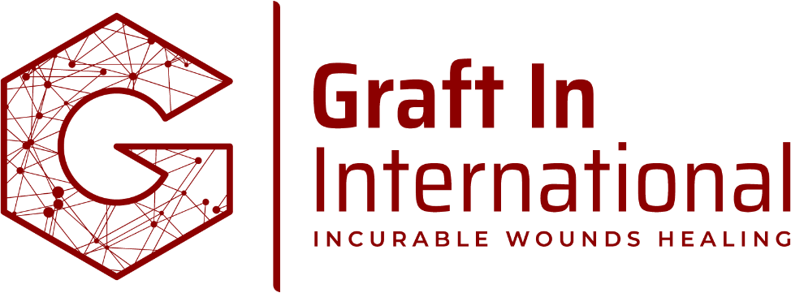
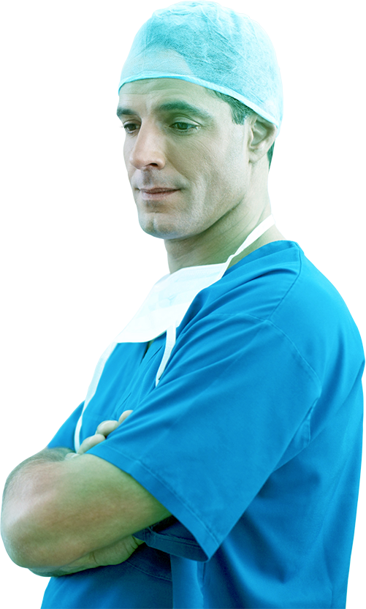
Patients Case Studies

Slide 17
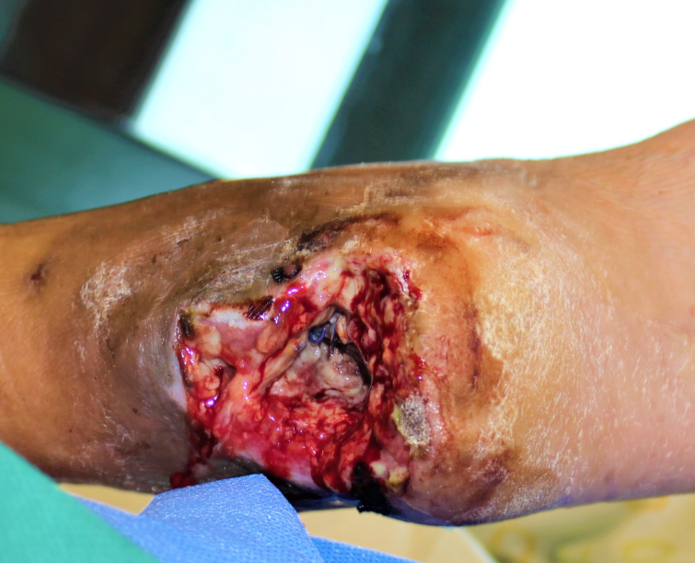
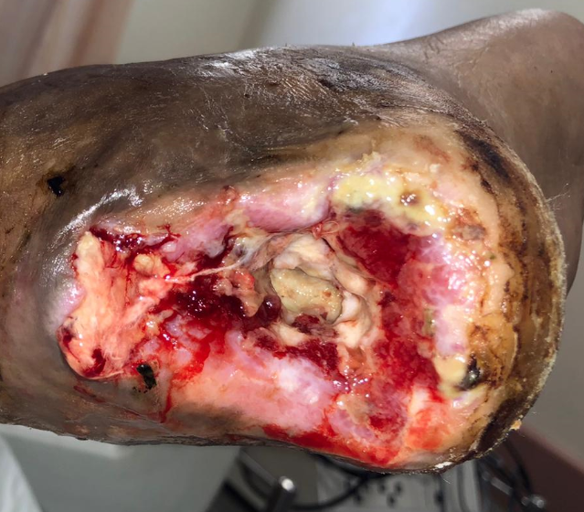
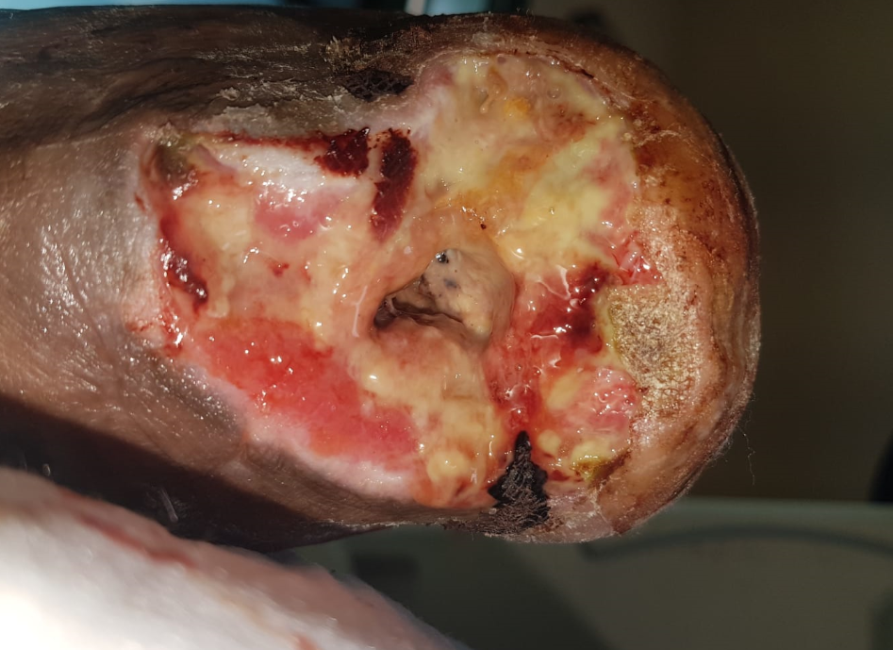
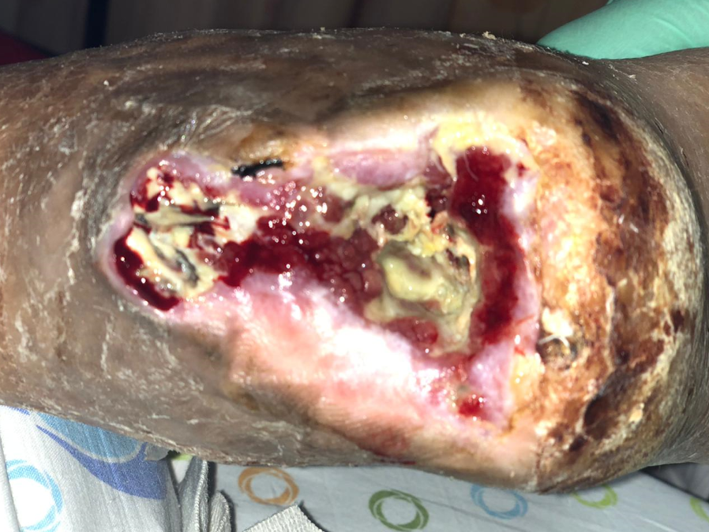
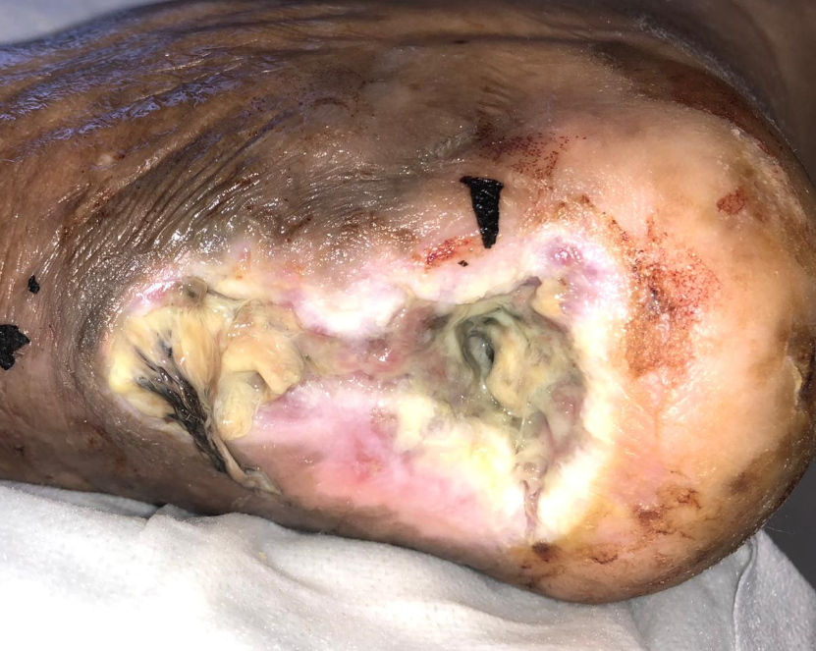
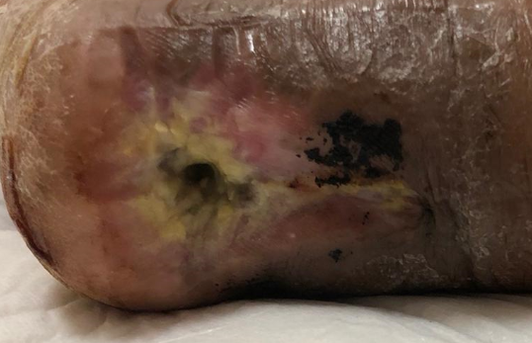
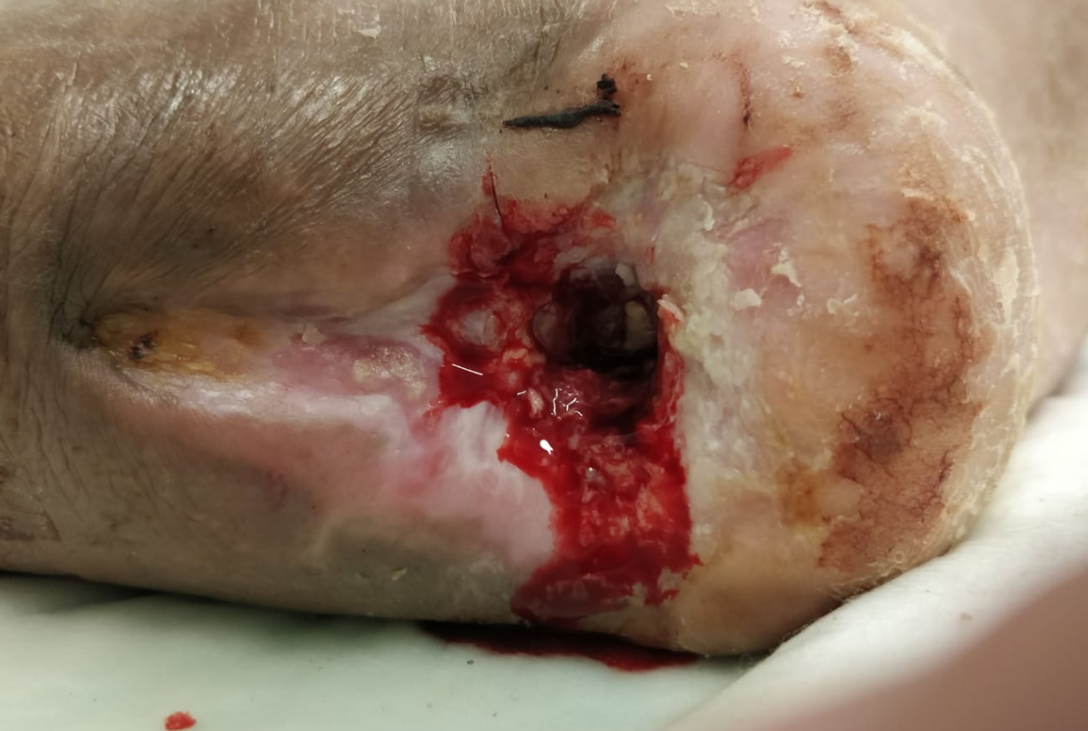
Diabetic heal (scheduled for amputation before treatment)
Treatment duration: 3.5 months
Number of treatments: 18
Day 1: 2.4.2020
Day110: 20.7.2020

Slide 18
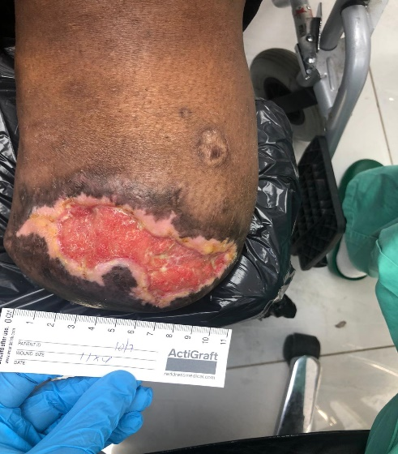
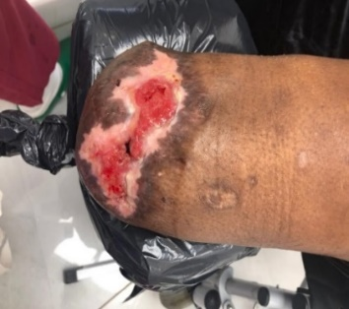
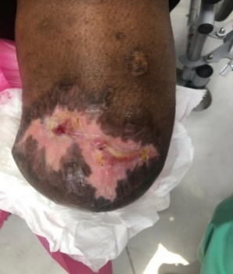
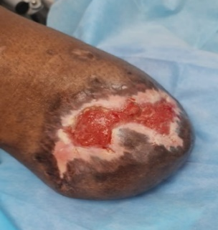
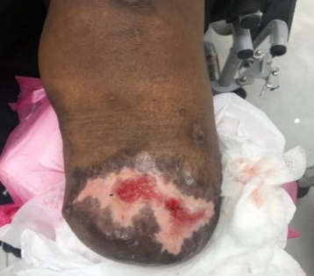
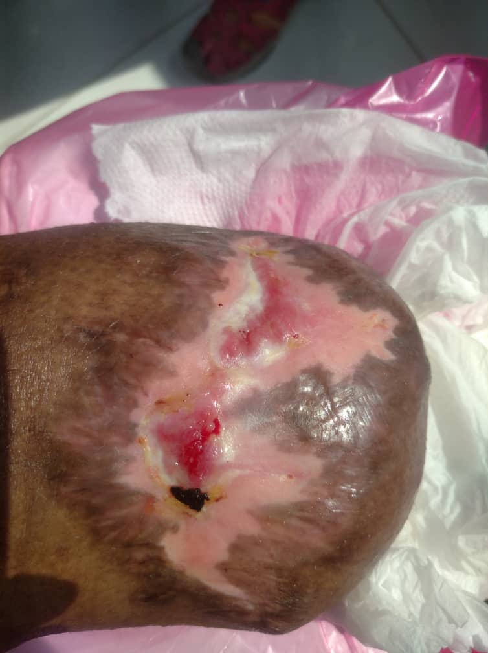
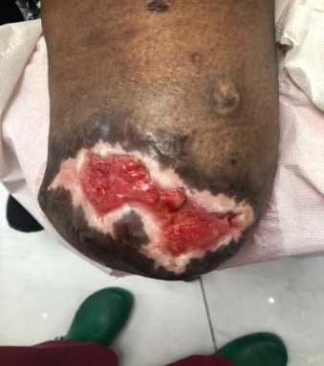
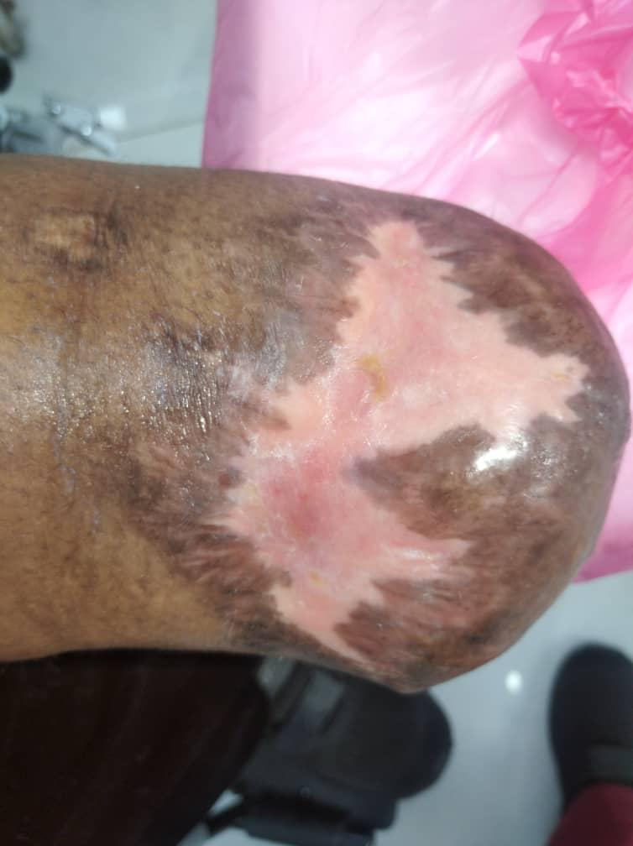
50 Y.O. Female - After leg amputation.
Medical background: Diabetic, H.B.P
Wound on stump, unable to put prosthesis for a year. No treatments helped.
Starting point
24.7.2022
28.7.2022
21.8.22
10.7.2022
17.7.2022
05.08.22
14.8.22
21.7.2022
After 8 treatments - complete healing
25.08.22

Slide 19
Starting point
After 8 treatments - complete healing
10.7.2022
25.08.22

Slide 20
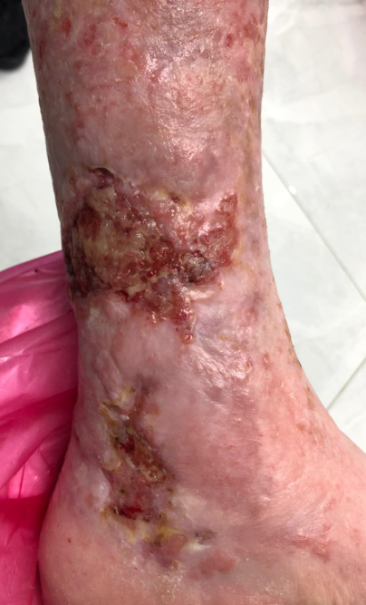
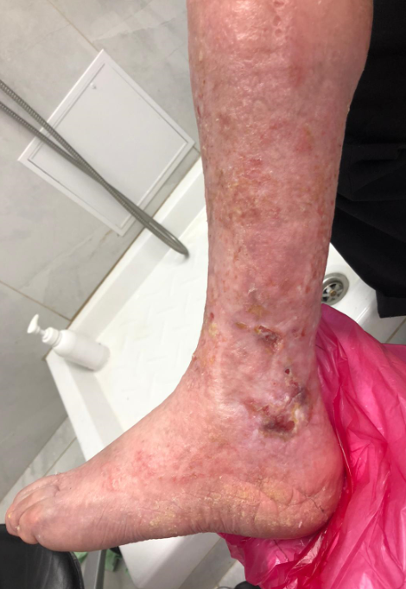
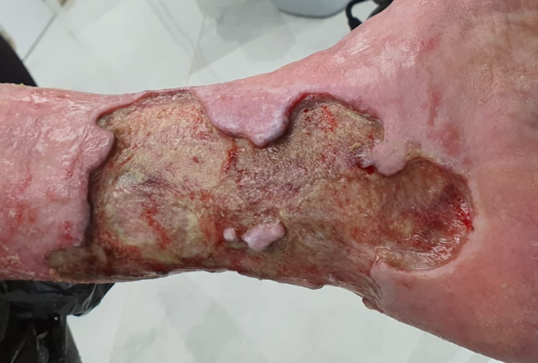
Diabetic Vascular wound (80 y.o.)
Treatment duration: 118 days
Number of treatments: 12
Starting condition: 06.05.20
Day-118: 30.08.20

Slide 21
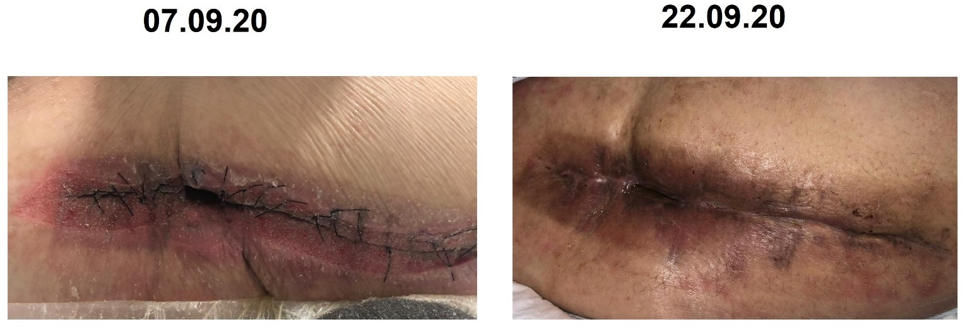
Male, 48 YO Non healing wound - the right upper thigh, after hip surgery 3 years ago Medical background:Obesity, Diabetic, broken hip, 3 years of hospitalization - non-healing post-surgical wound, currently 3 months Hospitalized. Past treatment: VAC, 5 Re-surgery and anything else they could find… ACTIGRAFT: First application poured into the wound 3 flowable clots and the wound was not even partly filled, last application (2 weeks later) the wound is closed and no space even for 1 clot.

Slide 22
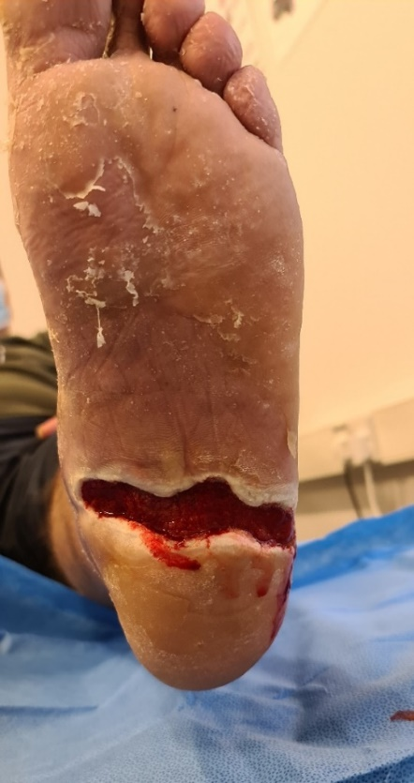
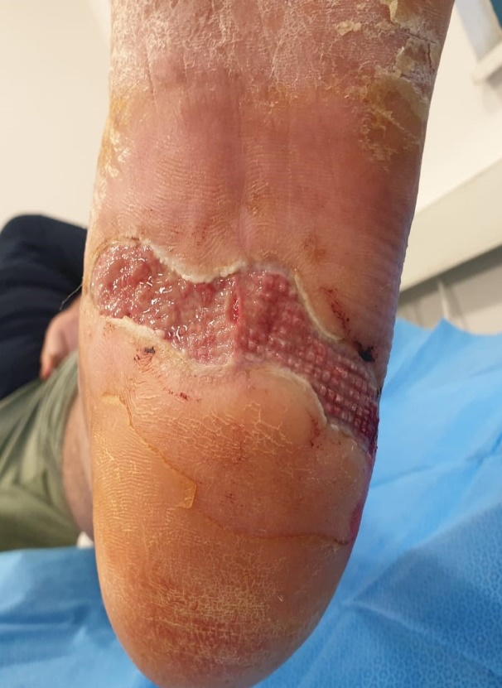
Male, 50 YO - Non healing diabetic wound for 10 months Medical background: Diabetic
Past treatment: anything they could find… Treatment duration: 3 days (!) graft was removed after 3 days in shower…
RESULT AFTER 3 DAYS ONLY!!! - No. of treatments: 1
Start point (first treatment) – 13.10.20 treatment 2 – 20.10.20 (graft removed on the 16.10)

Slide 23
65-year-old male
Medical background: Diabetic, severe neuropathy, hospitalized with the sepsis in foot, discharged from Hospital with referral for amputation.
Wound: Neuropathic Ulcer, before surgical removal, exposed tendons
ActiGraft treatment: 12 applications - 19 weeks

Slide 24
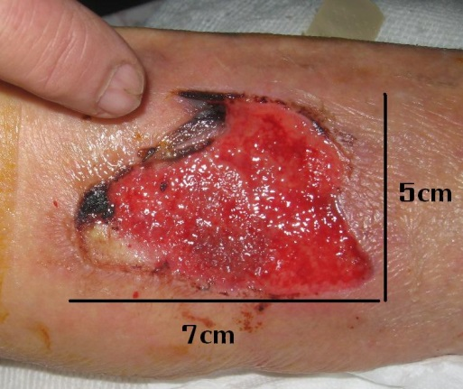
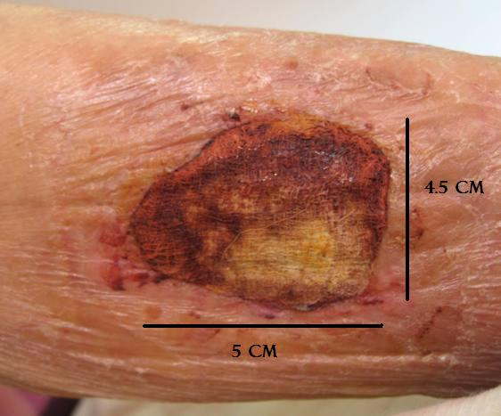
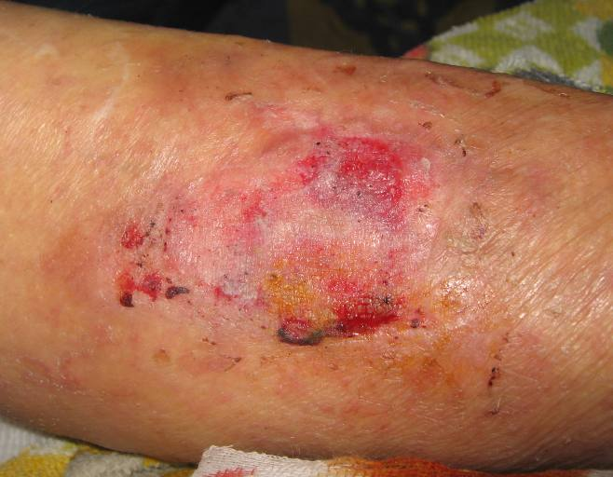
Skin tear on left shin Background: Static for 1 month prior to RD1 treatment. Treatment: One application for 3 weeks, until complete healing. ACTIGRAFT acts as a skin substitute for entire 3 weeks
Day 1 - 28cm²
Day 14 – RD1 still active
Day 21 - 0cm²

Slide 25
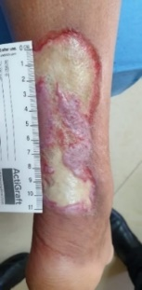
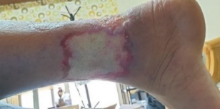
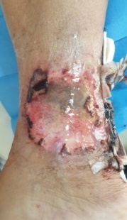
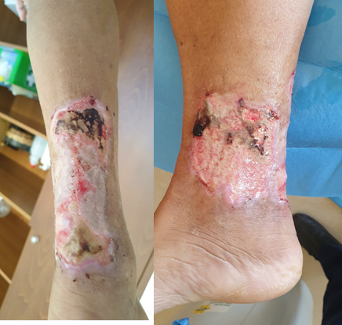
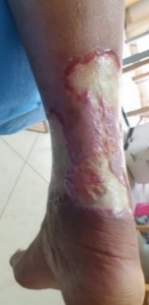
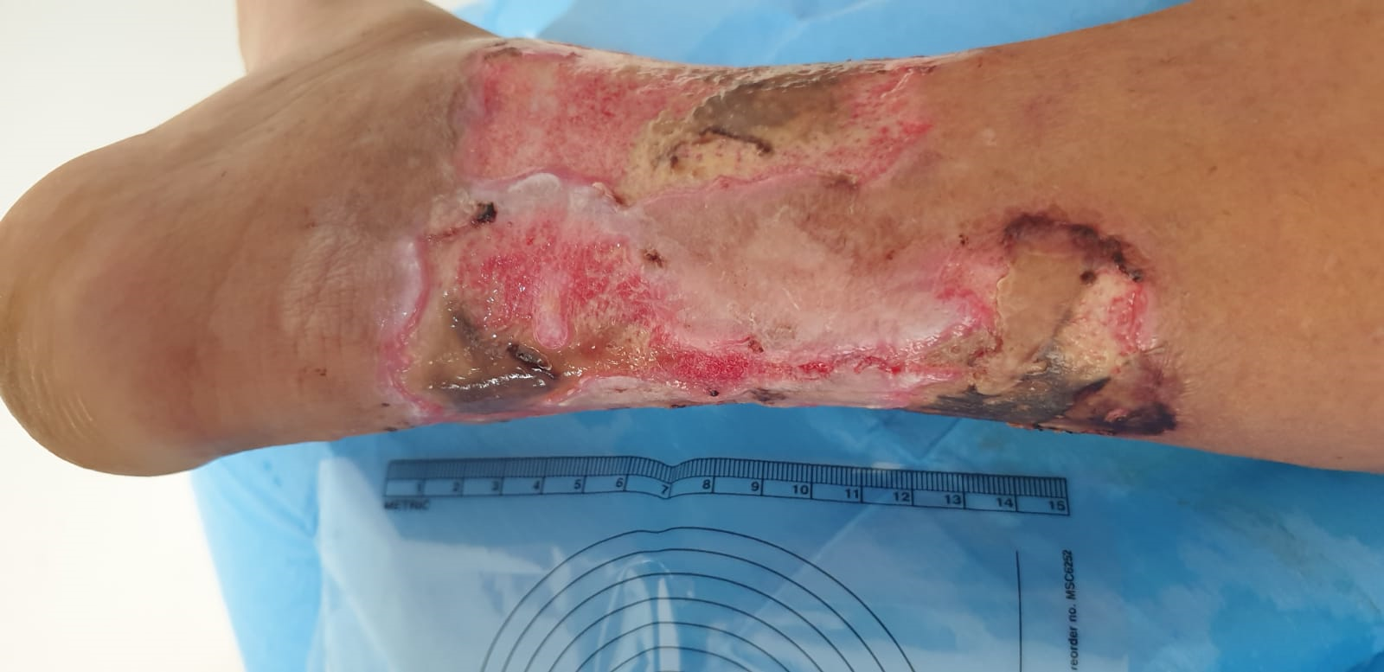
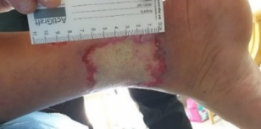
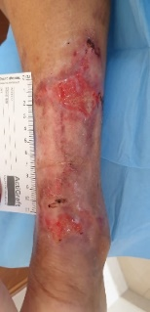
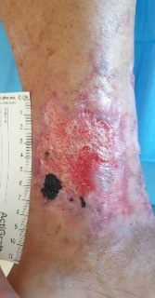
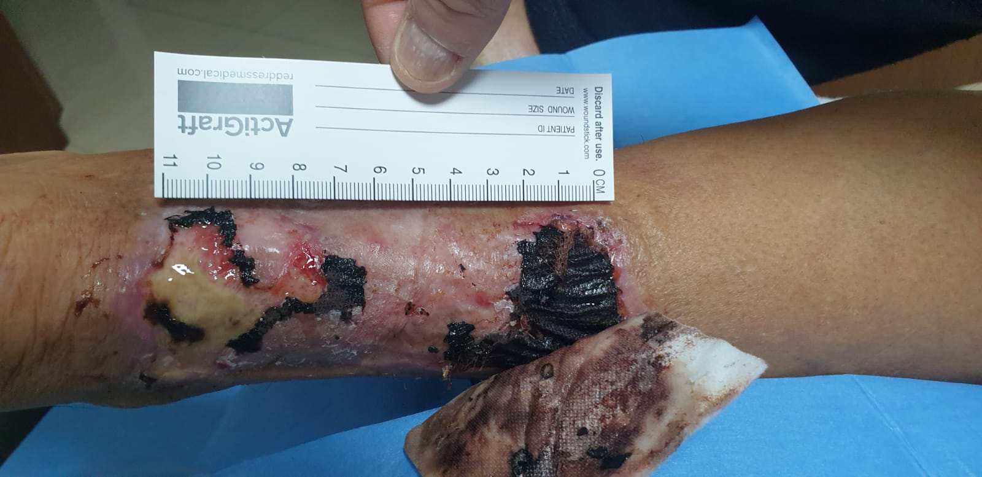
Male 63 YO Medical background: diabetic, 1-year non-healing wound. big wounds on two sides of the ankle, Previous treatments: many products, Ozon (made it worst). Pain killers: Mabron 100mg every 5 hours, now no pain killers at all
Start point 29.3.21 – first treatment
2nd treatment : 5.4.21
3rd treatment : 14.4.21
4th treatment : 21.4.21
7th treatment: 11.5.21
10th treatment : 31.5.21
Final stage - wound healed : 19.7.21
12th treatment : 14.6.21
15th treatment : 6.7.21

Slide 26
Additional applications and treatments NOT ONLY Chronic wounds

Slide 27
Post-Operative Wound
Medical background: bypass surgery, abdominal stitches not closed.
ActiGraft treatment: 7 application - 3 months

Slide 28
Gun shot injury in the palm background: no medical problems Treatment: 4 treatments until complete healing in 5 weeks

Slide 29
Knee Injury - 7 YO. Medical background: bicycle accident. sutured but it had large dehiscence ACTIGRAFT Treatment: 1 Actigraft & 2 weeks later plays football again

Slide 30
Preparation for skin transplant Past Ringworm radiation, suspected SCC, Vertex resection 5cm diameter. ACTIGRAFT on multiple points of exposed bone 1week\1 application - complete coverage - went on for a skin transplant
Right leg
Left leg

Slide 31
Internal Brest Cyst
Medical background: Breast abscesses
ACTIGRAFT treatment: 2 applications - 2 weeks
VIDEO
Start point (first treatment) - 29.12.20 treatment 2 - 05.01.21

Slide 32
Pilonidal sinus - 1 treatment with ACTIGRAFT

