Slide 1

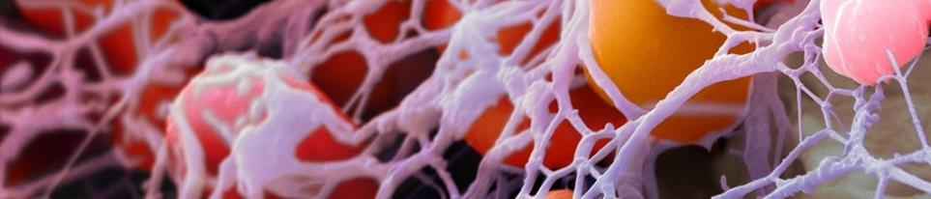
Recreating the Natural Wound Healing Environment

Slide 2
ACTIGRAFT
Biological Wound Care
Device/ Treatment
2

Slide 3
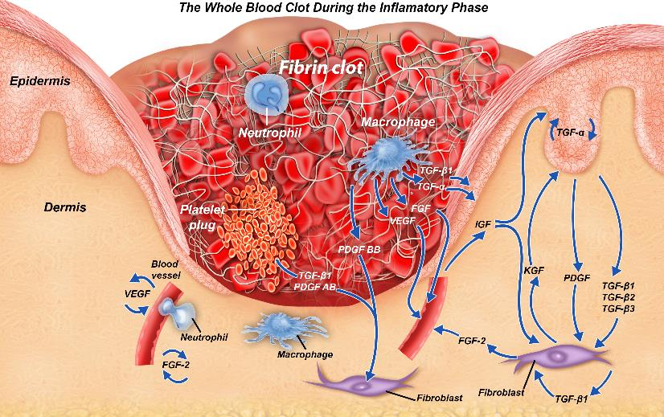
THE ACTIGRAFT WHOLE BLOOD CLOT:
CONTAINS ALL HEALING COMPONENTS
Protective Scab
Granulation
Tissue
Fibrin Scaffold
Released
Bio-signals
Released Growth factors
Macrophages & Fibroblasts

Slide 4
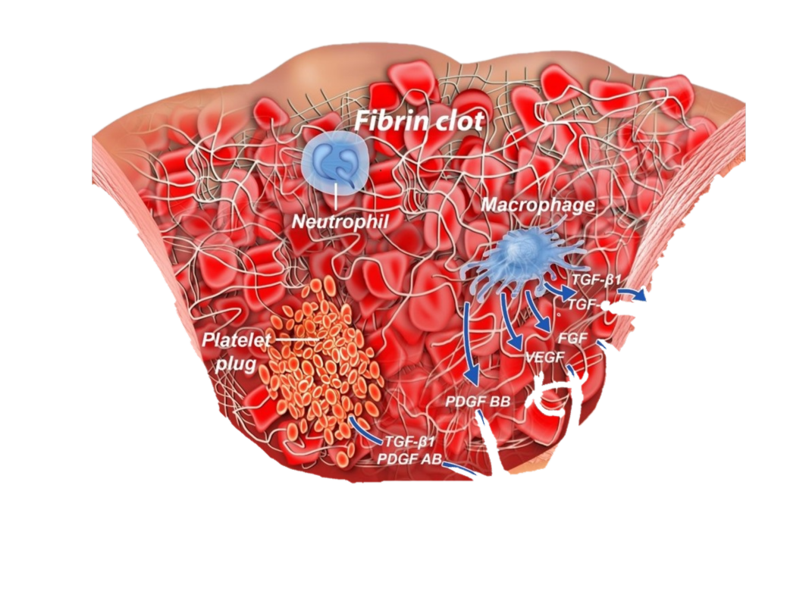
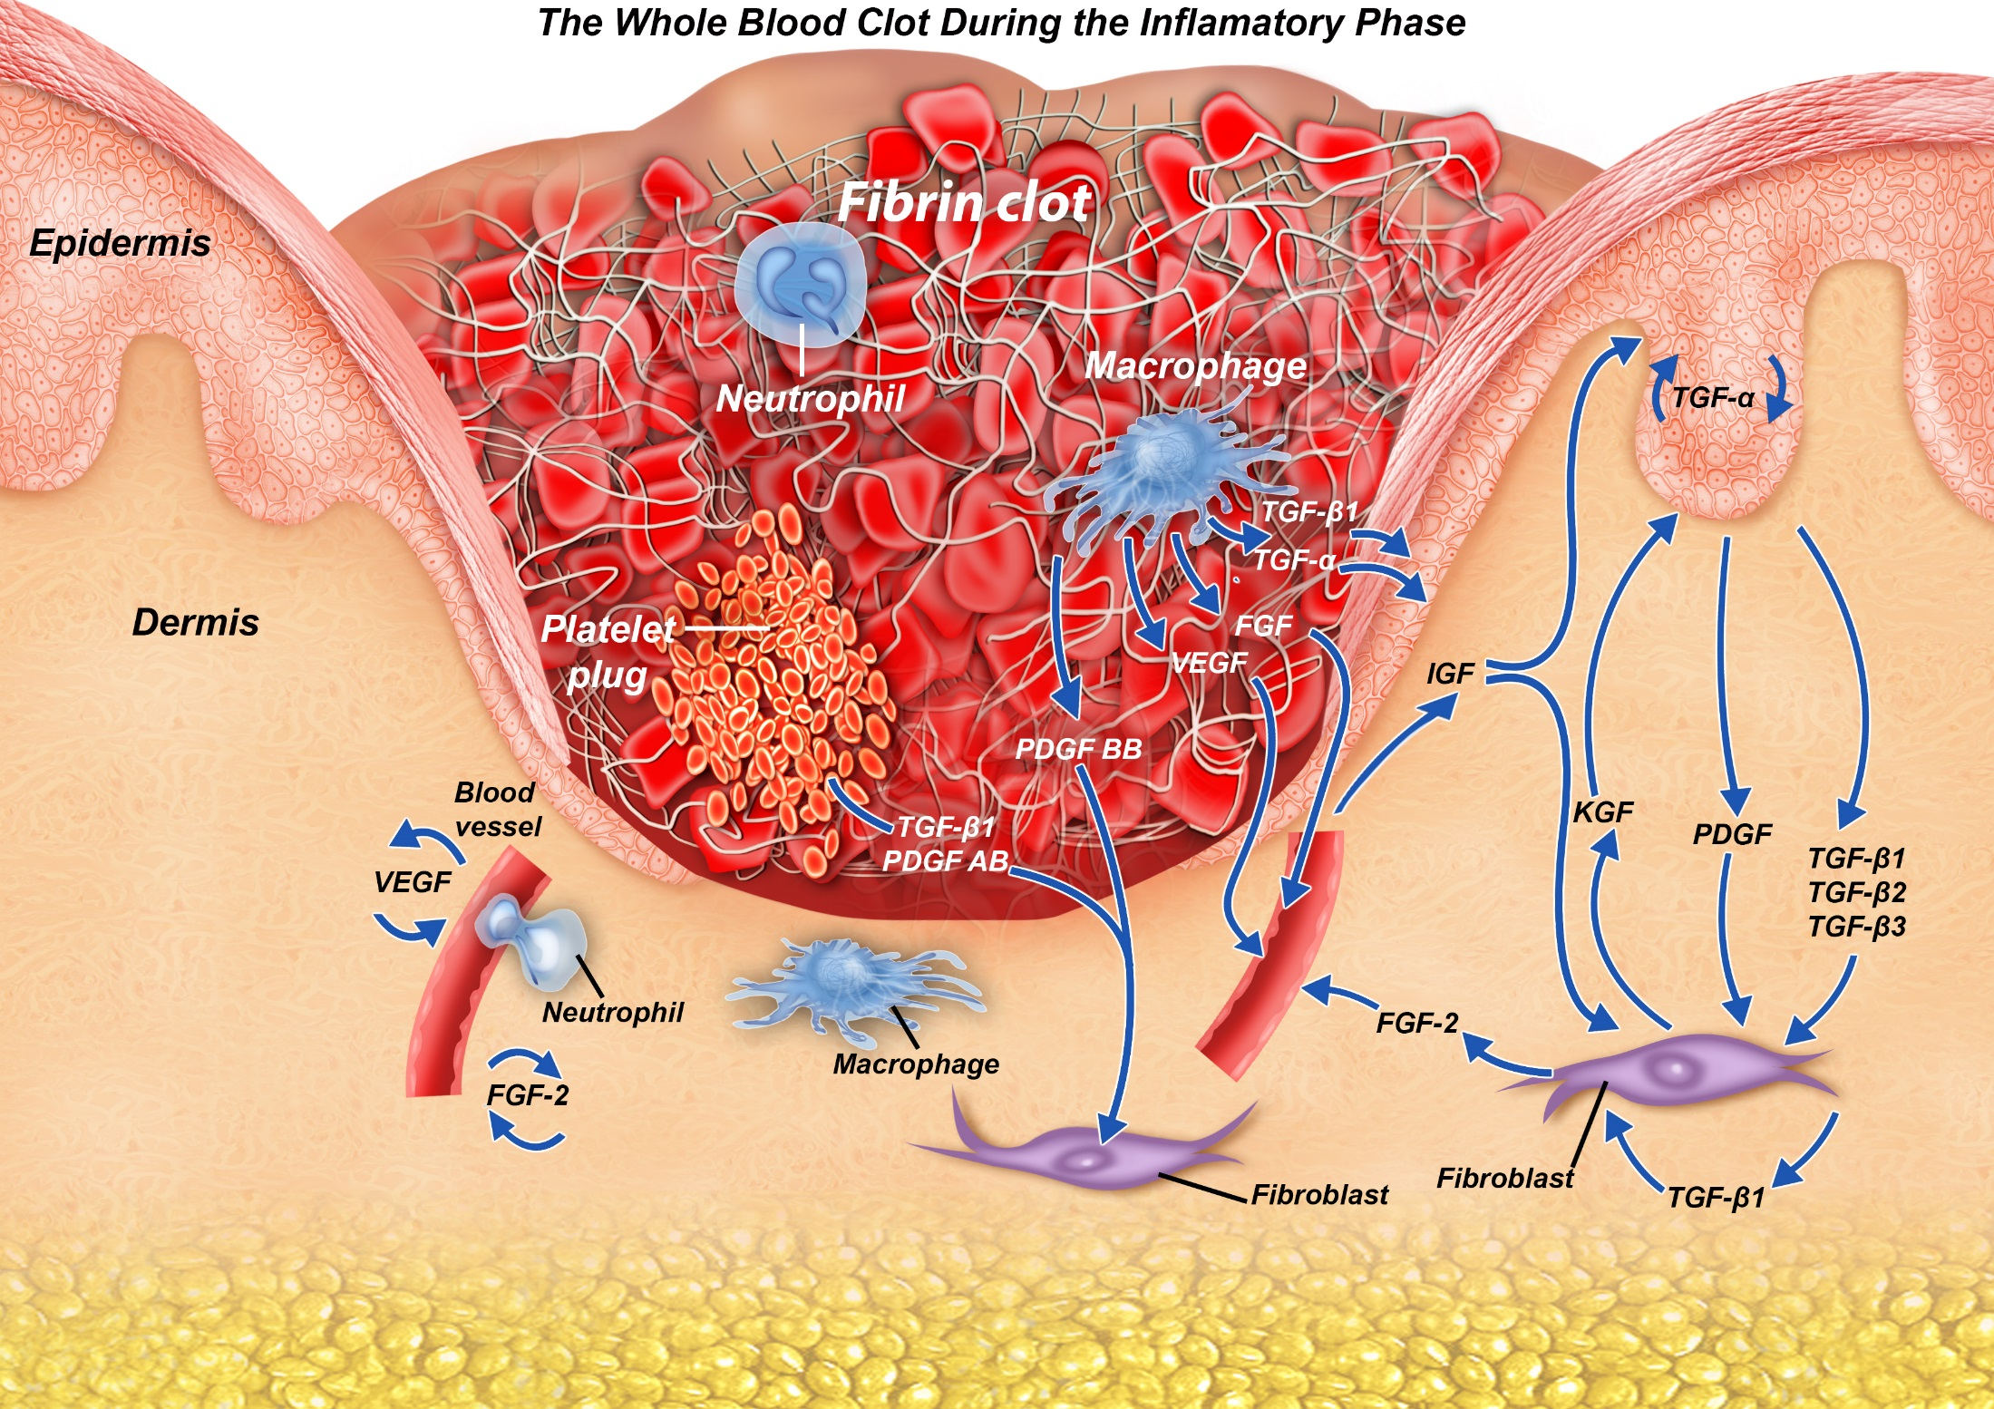
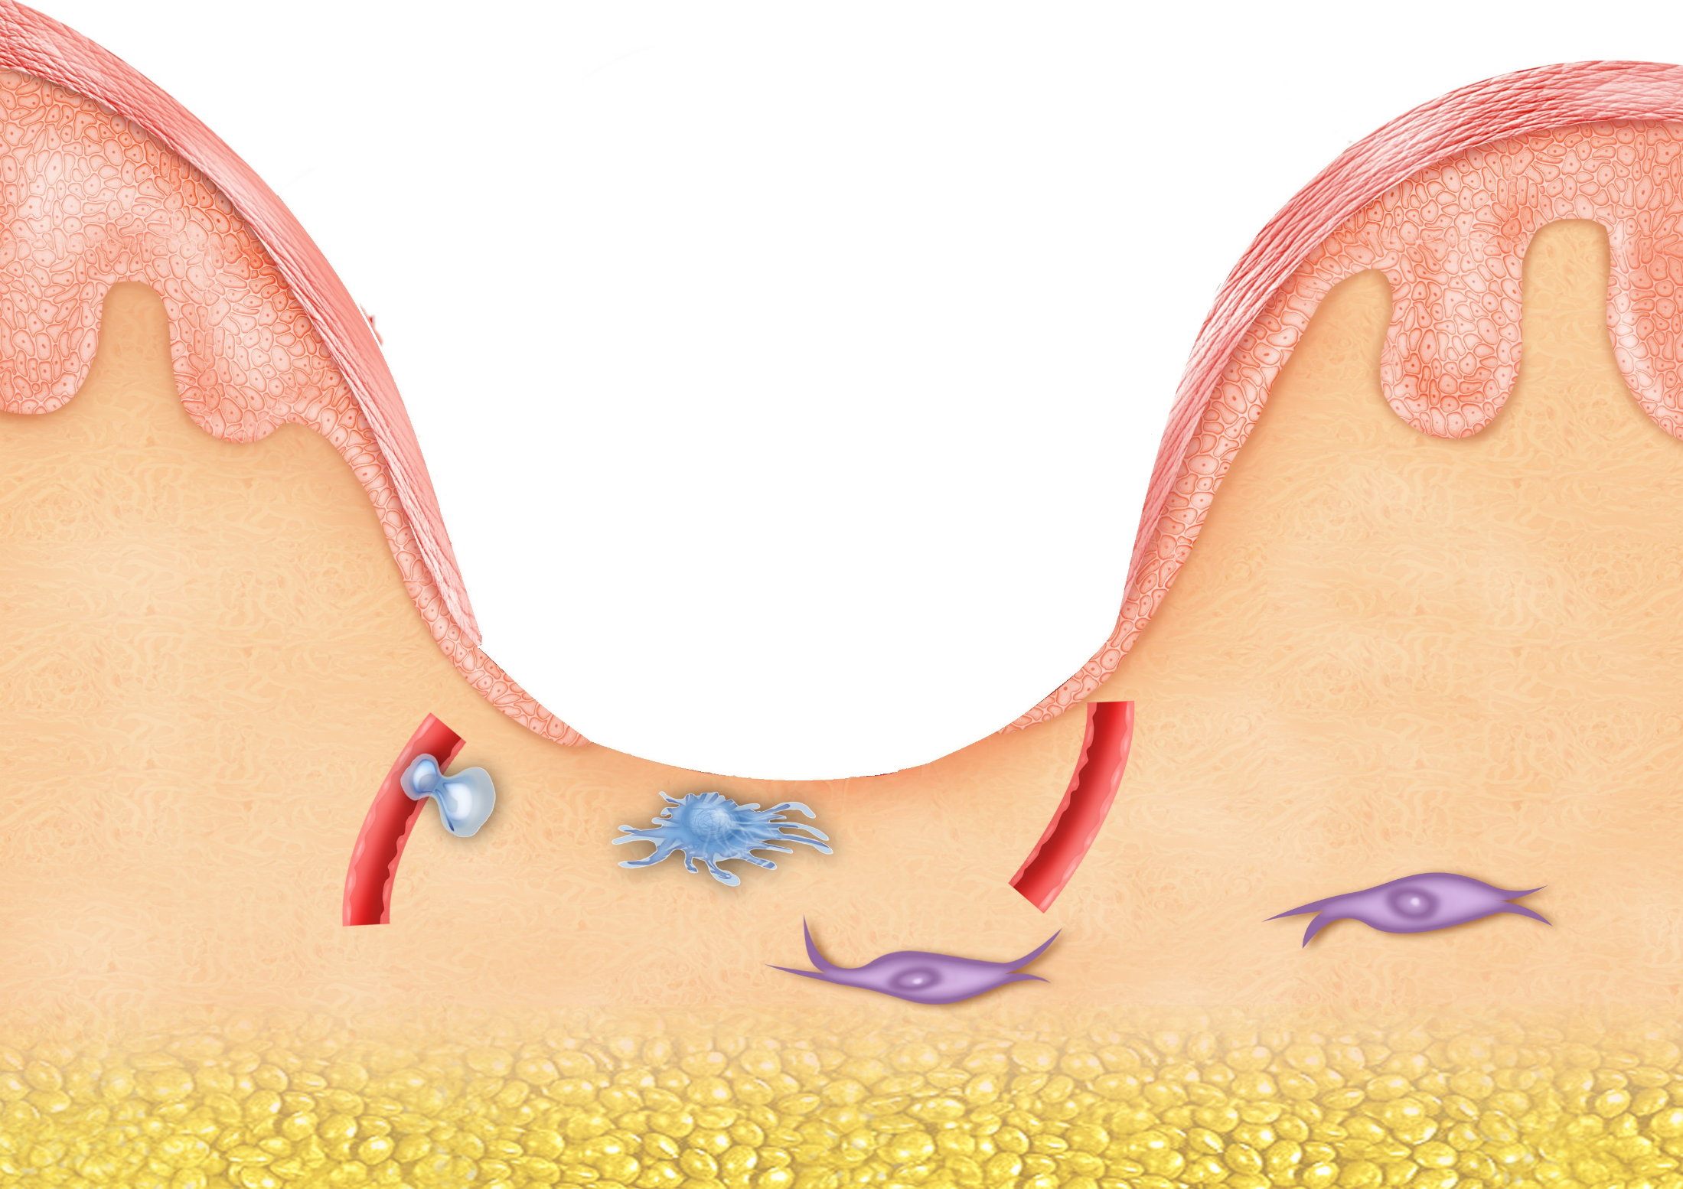

Slide 5
WOUND Management CASCADE
Today’s wound care standard
Multiple products = guessing game
Ozone
Patient QOL
Neg. Pressure
Wound Overexposure
Collagen
Wound treatment Guessing
Game
”Stuck”
Hospital Re-admissions
Silver
Nursing Time
Infection risk

Slide 6
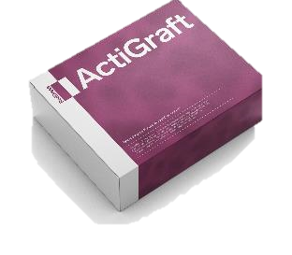
WOUND Management CASCADE
ActiGraft = solution to all the elements of wound management
Forms a protective scab
Prevent Infection
Normal healing
Signaling pathways for normal healing progress
Scaffolding for cell migration
ActiGraft takes the guessing game out of healing management cascade

Slide 7
ACTIGRAFT ADVANTAGES:
Using the patient’s own blood.
Initiates and moderates the healing process.
Promotes vascular growth.
Releases growth factors.
Attracts macrophages.
Acts as a scaffold.
Fight's infections.
Faster healing.
Remains active on the wound for prolonged periods (7 days).
Advanced biologic wound care to untreated chronic ulcers.
Effective healing and minimally nursing time = significant cost reduction.
7

Slide 8
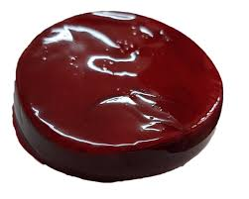
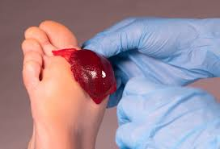
ACTIGRAFT OUTCOME
Solution to non-healing wounds.
Reduced pain.
Reduced healing time.
Reduced nursing visits.
Reduced cost.
Using the patient’s
own blood
8

Slide 9
ACTIGRAFT contra-indications and notes
Contra-Indications:
Malignant wounds
General infection
Notes & Remarks:
Make sure to perform a good thorough cleaning of the wound before the treatment.
Do not remove the ACTIGRAFT for 7 days.
Change external dressing after 3 days.
Severe wounds: minimum of 3-4 treatments/weeks for improvement.
Severe wounds require a minimum of 10 treatments for healing.
9

Slide 10
ACTIGRAFT
Vs.
Other treatments
10

Slide 11
Biological Treatments - Comparison
11

Slide 12
NEGATIVE WOUND PRESSURE THERAPY
Regenerative wound solution using patient's own blood to create an autologous whole blood clot tissue
vacuum assisted closure using a suction pump to remove excess exudate and promote healing
Requires 1 weekly application, every 7 days
Requires 2-3 dressing changes per week
No irritation of the dermal layer of the skin, pain reduction has been noted in 3 days
Patient may experience pain from vacuum, and at dressing changes
Minimized infection risk due to leaving wound undisturbed and reduced dressing changes
Frequent dressing changes increase contamination risk and infection; vacuum seal leakage can cause maceration, infection, and complications
Utilizing patient's own blood creates a natural healing environment
Not biologically active - Exposed to side effects
No Capital equipment or special storage
requirements
Purchase or rental of capital equipment is required as well as purchase of disposables
Ease of use enables deployment across care continuum and transition from acute to post-acute setting
trained nursing staff and frequent monitoring required to conduct in-servicing, competency updates to troubleshoot alarms, repair leaks, observe complications
Reduces risk of hospital readmissions
Complications can lead to patient readmissions spital
72.2% complete healing in average of 6 weeks (45 days) = cost reduction for complete healing
43.2% partial healing in 14 weeks (98 days).

Slide 13
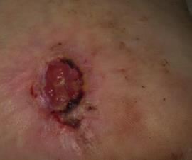
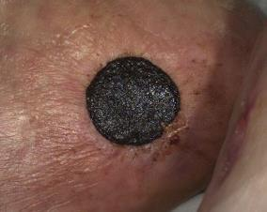
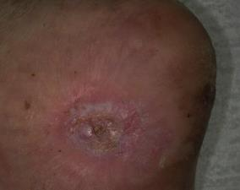
Reduction of Nursing - Example Case
Diabetic foot ulcer (DFU): Actigraft Clinged to the wound - Left untouched for
4 consecutive weeks with zero wound nursing, after which the wound was healed.
Cost comparison:
Cost of regular daily care of such ulcer in Home Nursing during these 4 weeks will be around €1,500+ with daily care while the ulcer will not heal in most cases.
The cost with ACTIGRAFT is €350 per treatment.
The DFU before RD1 – non healing for 7 months
The RD1 on the wound after 4 consecutive weeks
The healed DFU after 4 weeks with one RD1
13

Slide 14
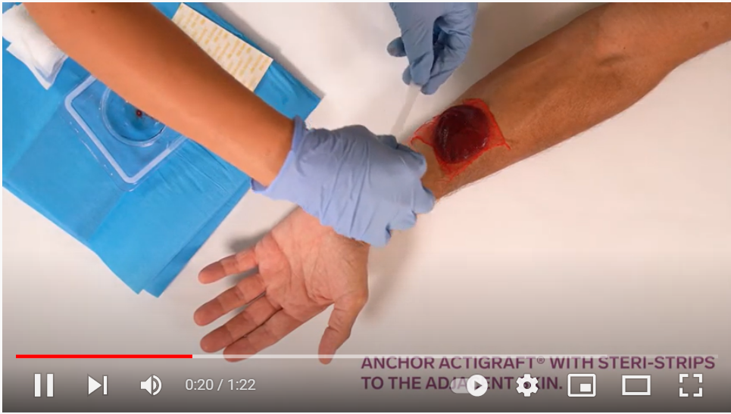
ACTIGRAFT preparation and application

Slide 15
ACTIGRAFT - Good For:
Chronic wounds:
Diabetic Ulcers.
Pressure Ulcers.
Vascular Ulcers.
Non-healing wounds.
Accelerate and improve healing of difficult to heal wounds:
Pilonidal Sinus
Annal fistula
Stoma removal wound
Internal Cyst
Gun shut wound
15

Slide 16
Recreating the Natural Wound Healing Environment

