Slide 1

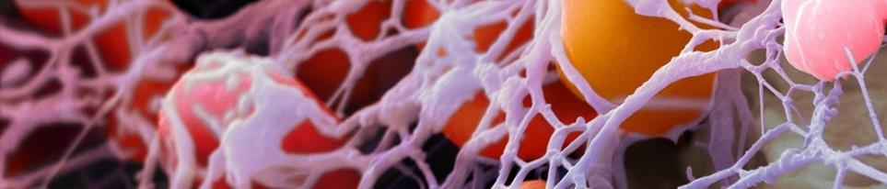
Recreating the Natural Wound Healing Environment
ACTIGRAFT
Biological Wound Care Device/ Treatment

Slide 2
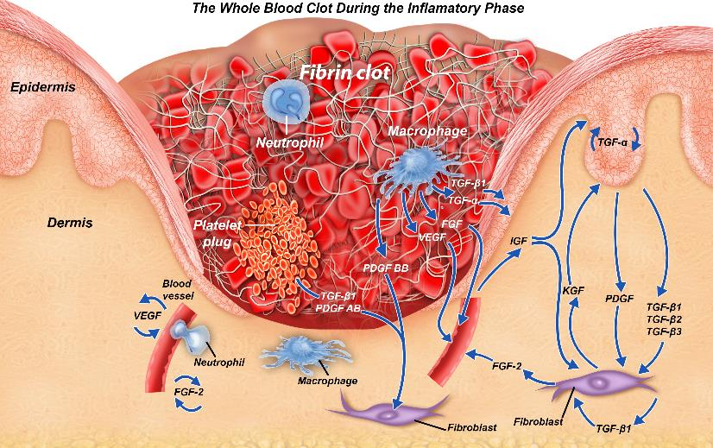
THE ACTIGRAFT WHOLE BLOOD CLOT:
CONTAINS ALL HEALING COMPONENTS
Protective Scab
Granulation
Tissue
Fibrin Scaffold
Released
Bio-signals
Released Growth factors
Macrophages & Fibroblasts

Slide 3
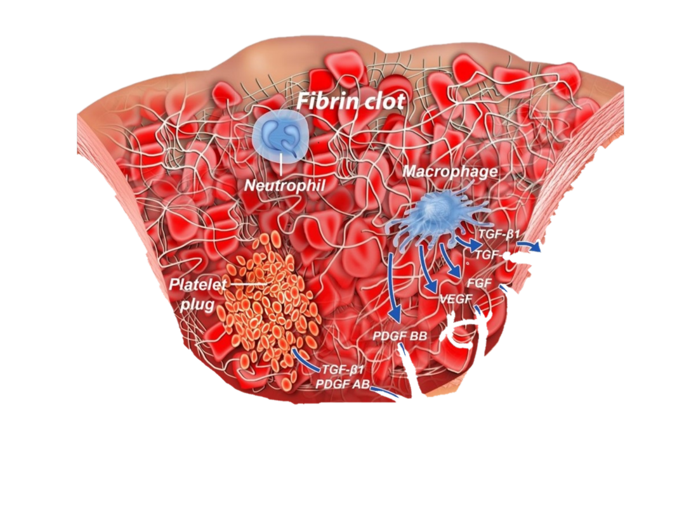
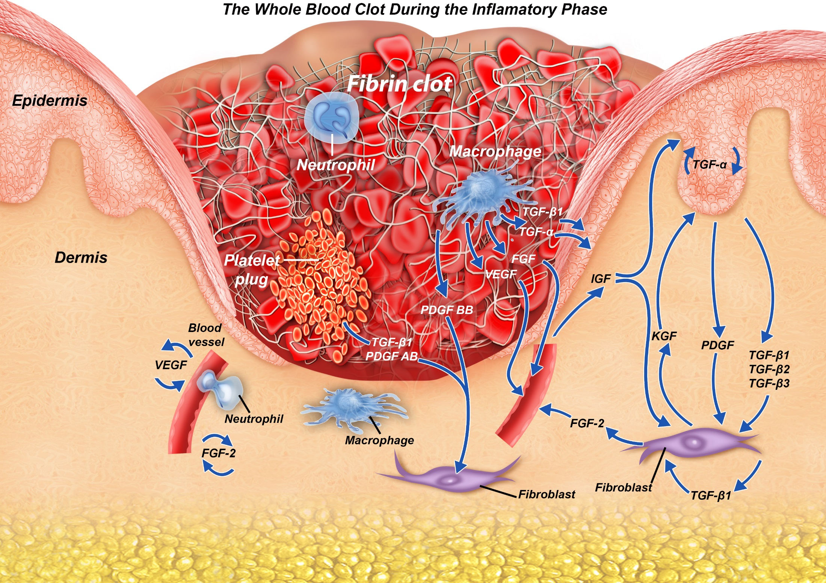
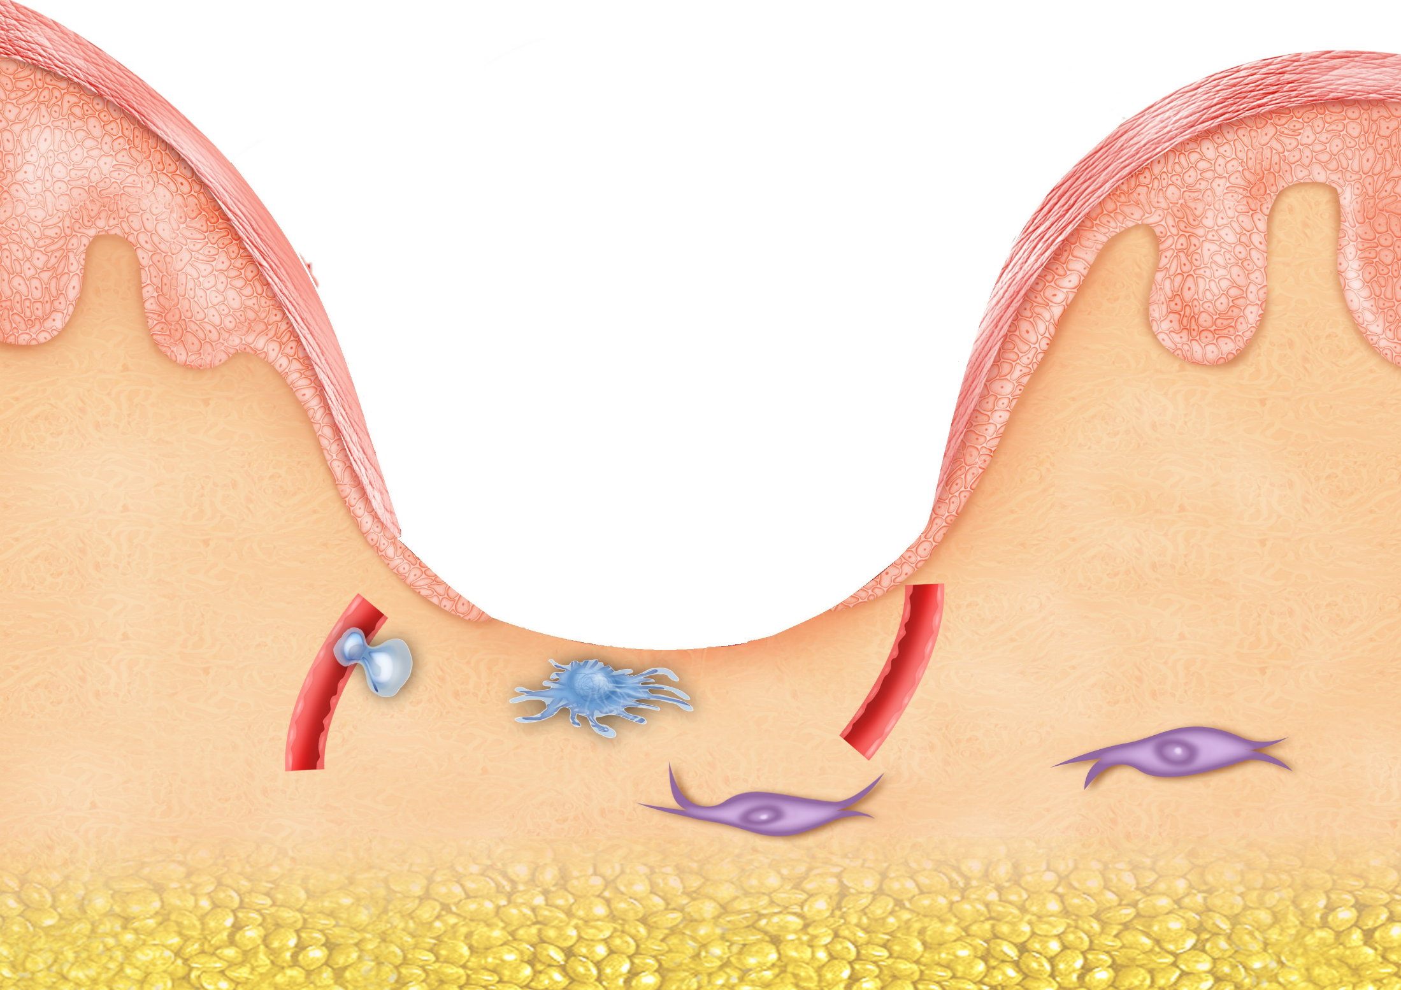

Slide 4
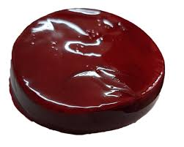
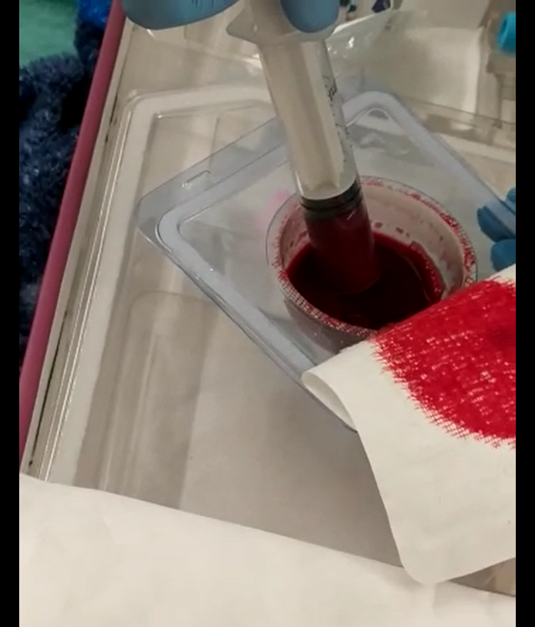
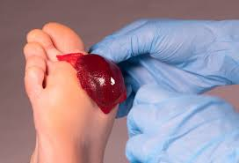
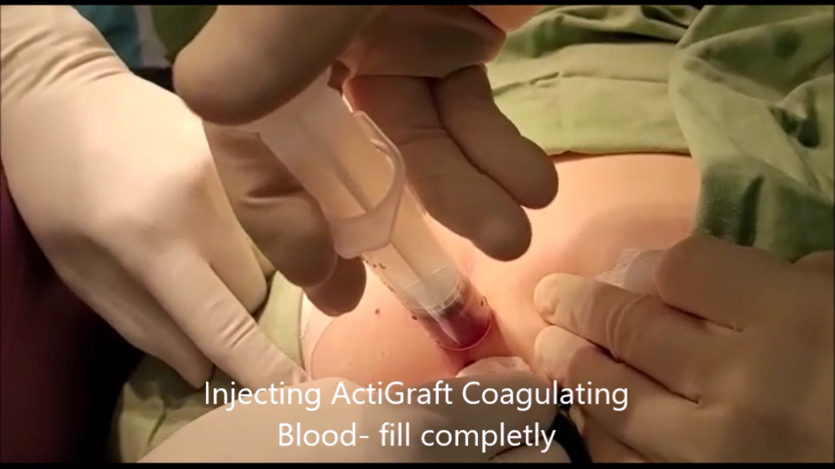
Treatment Options
ACTIGRAFT - Blood Clot
ACTIGRAFT - Liquid App.

Slide 5
WOUND Management CASCADE
Today’s wound care standard
Multiple products = guessing game
Ozone
Patient QOL
Neg. Pressure
Wound Overexposure
Collagen
Wound treatment Guessing
Game
”Stuck”
Hospital Re-admissions
Silver
Nursing Time
Infection risk

Slide 6
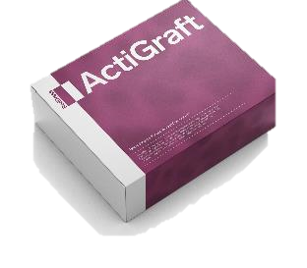
WOUND Management CASCADE
ActiGraft = solution to all the elements of wound management
Forms a protective scab
Prevent Infection
Normal healing
Signaling pathways for normal healing progress
Scaffolding for cell migration
ActiGraft takes the guessing game out of healing management cascade

Slide 7
ACTIGRAFT ADVANTAGES:
Using the patient’s own blood.
Initiates and moderates natural healing process.
Promotes vascular growth.
Releases growth factors.
Acts as a scaffold.
Attracts macrophages.
Fight's infections.
Faster healing.
Remains active on the wound for prolonged periods (7 days).
Effective healing and minimally nursing time = significant cost reduction.
7

Slide 8
ACTIGRAFT contra-indications and notes
Contra-Indications:
Malignant wounds
General infection
Notes & Remarks:
Make sure to perform a good thorough cleaning of the wound before the treatment.
Do not remove the ACTIGRAFT for 7 days.
Change external dressing after 3 days.
Severe wounds: minimum of 3-4 treatments/weeks for improvement.
Severe wounds require a minimum of 10 treatments for healing.
8

Slide 9
ACTIGRAFT - Good For:
Chronic wounds:
Diabetic and Neuropathic Ulcers
Pressure & Vascular Ulcers.
Non-healing wounds.
Accelerate and improve healing of difficult to heal wounds:
Traumatic Wounds
Surgical & Post-Surgical Wounds
Skin Tears
Pilonidal Sinus
Annal fistula
Stoma removal wound
Internal Cyst
Gun shut wound
9

Slide 10
ACTIGRAFT
Vs.
Other treatments
10

Slide 11
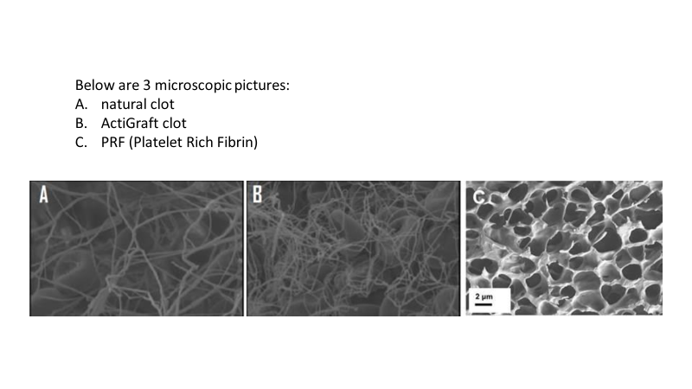
ACTIGRAFT vs. PRP
ACTIGRAFT
ACTIGRAFT vs. PRF
Natural Clot
ACTIGRAFT Clot
PRF (Platelet Reach Fibrin)

Slide 12

ACTIGRAFT | PRP (Platelet-rich plasma) | PRF, Growth factors & other blood products
A three-dimensional matrix containing a fibrin net, which forms a stable basis for growth factors and blood vessels, migration of cells, capturing of fluids, optimal distance between cells. | Liquid and unstable on the wound - there is no basis to support the growth factors to develop | Engineered in 3-layer product, lower layer is in contact with the wound, next 2 layers do not contact and cannot directly interact with the wound.
A blood clot formation creates a slow and controlled discharge according to the natural needs of the body | Liquid condition results in a rapid discharge and a significant decrease in the effectiveness of the treatment process | Destroy the natural balance of the natural wound environment created in a blood clot
A blood clot in the natural dose to the body | High concentration and not in whole blood composition - is not effective. (Example: in giving antibiotics do not take twice as many times to get a faster recovery) | by centrifuge, results in a very dense and rigid fibrin product, has no resemblance to how a natural fibrin scaffold should look
A natural evolutionary process of the body | Separation of blood components is not a natural healing process of the body | Processed blood product.

Slide 13
Biological Treatments - Comparison
(Embryonic cells)
13

Slide 14
NEGATIVE WOUND PRESSURE THERAPY
Regenerative wound solution using patient's own blood to create an autologous whole blood clot tissue
vacuum assisted closure using a suction pump to remove excess exudate and promote healing
Requires 1 weekly application, every 7 days
Requires 2-3 dressing changes per week
No irritation of the dermal layer of the skin, pain reduction has been noted in 3 days
Patient may experience pain from vacuum, and at dressing changes
Minimized infection risk due to leaving wound undisturbed and reduced dressing changes
Frequent dressing changes increase contamination risk and infection; vacuum seal leakage can cause maceration, infection, and complications
Utilizing patient's own blood creates a natural healing environment
Not biologically active - Exposed to side effects
No Capital equipment or special storage
requirements
Purchase or rental of capital equipment is required as well as purchase of disposables
Ease of use enables deployment across care continuum and transition from acute to post-acute setting
trained nursing staff and frequent monitoring required to conduct in-servicing, competency updates to troubleshoot alarms, repair leaks, observe complications
Reduces risk of hospital readmissions
Complications can lead to patient readmissions spital
72.2% complete healing in average of 6 weeks (45 days) = cost reduction for complete healing
43.2% partial healing in 14 weeks (98 days).

Slide 15
Recreating the Natural Wound Healing Environment

